Slide 1

Introduction to Software Engineering (ISE102) Tutorial Week 4

Slide 2
Week 4 Outline
What Are Control Statements?
Conditional Statements
If-Else Example: Voting Eligibility in Python
Activity 1: Try Different Ages
If-Else Example: Voting Eligibility in Java
Activity 2: Add a Second Condition
Looping Statements
Jump Statements
Bank Case Study (Link to Lab 4)
Activity 3: Try Different Transactions
Activity 4: Simulate a Blocked Account
Learning Reinforcement (2 min)
Activities 5 and 6
Problem-Solving Example (Factorial – Lab 4 Ex.8) – Python
Problem-Solving Example (Factorial – Lab 4 Ex.8) – Java
Activity 7
Role-Playing Debate Questions (2 min)
Lab 4 Exercises
Have you formed your group?
Tuesday Class 4-6 PM: Farshid Keivanian (main) Xiaojie (Zoe) Lin covers:
12 August
26 August
9 September
14 October

Slide 3
What Are Control Statements?
Control statements = traffic lights of programming
They decide the flow of your program
Types:
Conditional Statements → if, else, switch
Looping Statements → for, while, do-while
Jump Statements → break, continue, return
Analogy: Think of cooking in a kitchen – you decide (if), repeat stirring (loop), or stop cooking (break).

Slide 4
Conditional Statements
if-else: Makes decisions
switch: Menu of choices (like choosing a meal at a café)
Syntax is similar in Java and Python (Python uses indentation, Java uses braces).

Slide 5
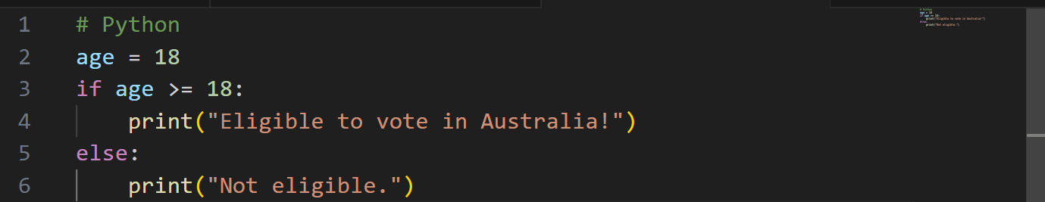
If-Else Example: Voting Eligibility in Python
1. Variable: A variable called age is created.
It is given the value 18.
In Python, you don’t need to write the type (int like in Java). Python figures it out automatically.

Slide 6
If-Else Example: Voting Eligibility in Python
2. If-else condition: if age >= 18:
Checks if age is greater than or equal to 18.
If true, it runs the code under this block → prints: Eligible to vote in Australia!

Slide 7
If-Else Example: Voting Eligibility in Python
else:
Runs only if the if condition is false.
Prints: Not eligible.

Slide 8
If-Else Example: Voting Eligibility in Python
3. Indentation
In Python, indentation (spaces at the beginning of the line) is very important.
The print(...) lines must be indented under if or else.

Slide 9
If-Else Example: Voting Eligibility in Python
Program Flow
Start at the top.
Store age = 18.
Check if age >= 18.
Since 18 is equal to 18 → condition is true.
Output

Slide 10
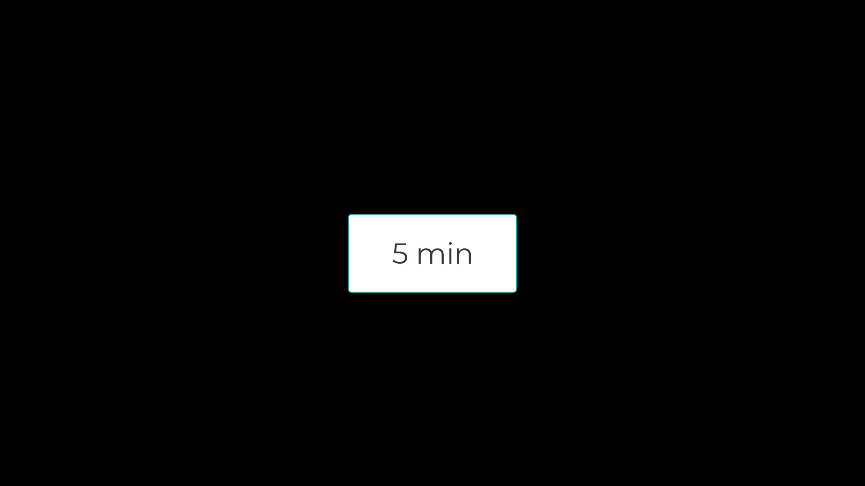
Activity 1: Try Different Ages
Task: Change the value of age and run the program. Test with at least three different ages:
Below 18 (e.g., 15)
Exactly 18
Above 18 (e.g., 25)
Goal: Students see how the program reacts differently for each case.

Slide 11
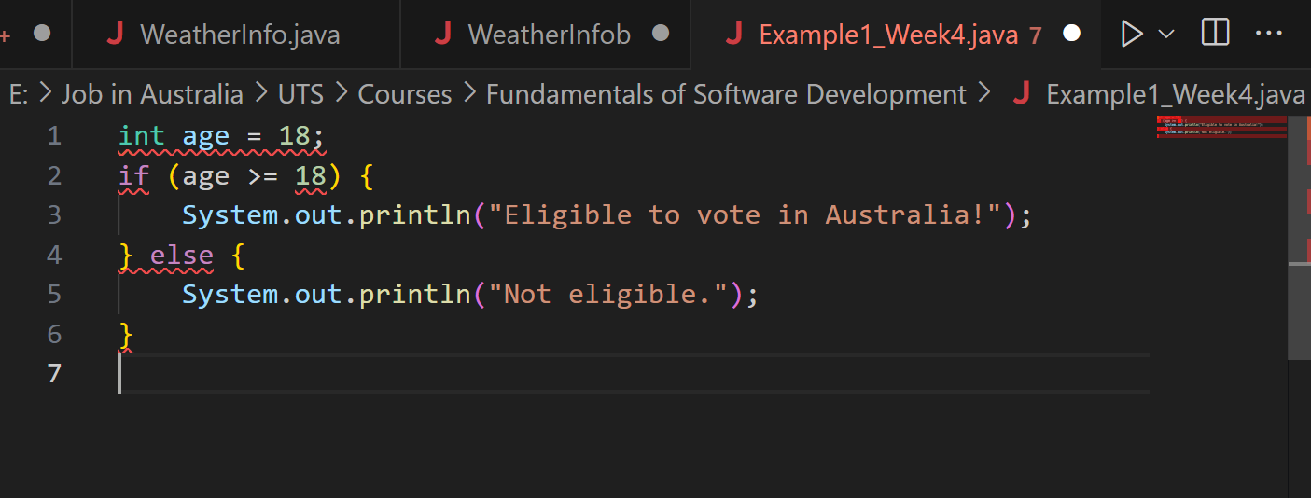
If-Else Example: Voting Eligibility in Java
Error: Main method not found in the file, please define the main method...
This is happening because Java needs a main method as the entry point of our program. Our code only has an if statement without wrapping it inside a class and a main method.

Slide 12
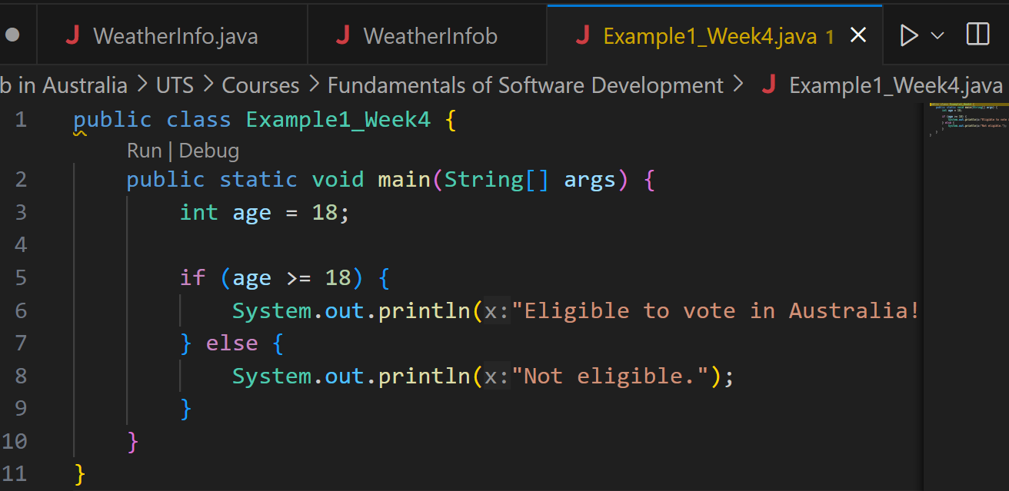
If-Else Example: Voting Eligibility in Java
1. Class: In Java, all code must be inside a class.
The class name (Example1_Week4) must match the file name (Example1_Week4.java).

Slide 13
If-Else Example: Voting Eligibility in Java
2. Main Method: This is the entry point of any Java program.
When you click Run, Java looks for this method to start the program.
String[] args allows input from the command line (not used here, but required).

Slide 14
If-Else Example: Voting Eligibility in Java
3. Variable: A variable named age is created and given the value 18.
int means it’s a whole number (integer).

Slide 15
If-Else Example: Voting Eligibility in Java
4. If-else condition: if checks the condition (age >= 18).
If true → print "Eligible to vote in Australia!".
If false → print "Not eligible.".

Slide 16
If-Else Example: Voting Eligibility in Java
5. Closing braces:
Close the main method, then close the class.

Slide 17
If-Else Example: Voting Eligibility in Java
Program Flow: Start at main.
Store age = 18.
Check if age is 18 or more.
Since it is, print:

Slide 18
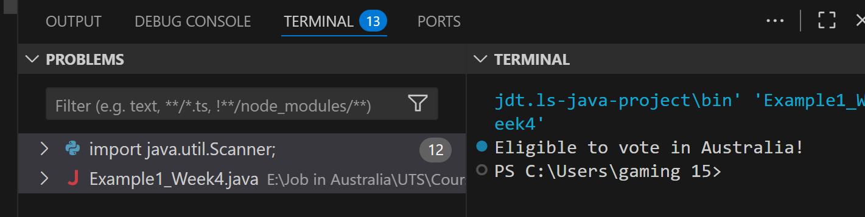
If-Else Example: Voting Eligibility in Java

Slide 19
Activity 2: Add a Second Condition
Task: Modify the if–else to include a new condition:
Age < 18 → "Not eligible."
Age between 18 and 70 → "Eligible to vote in Australia!"
Age > 70 → "Optional voting in Australia."
Goal: Students practice adding conditions (else if) and understand how real-world rules can be modeled in code.

Slide 20
Looping Statements
Repeat tasks until a condition is met
for loop → like counting seats in a lecture hall
while loop → keep walking until the bus arrives
do-while loop (Java only) → at least one attempt (like trying your Opal card tap even if balance is low)

Slide 21
Jump Statements
break → leave the loop early (like leaving a class early if fire alarm rings )
continue → skip one step, move to next (like skipping one stop while driving Uber Eats)
return → exit from the method completely

Slide 22
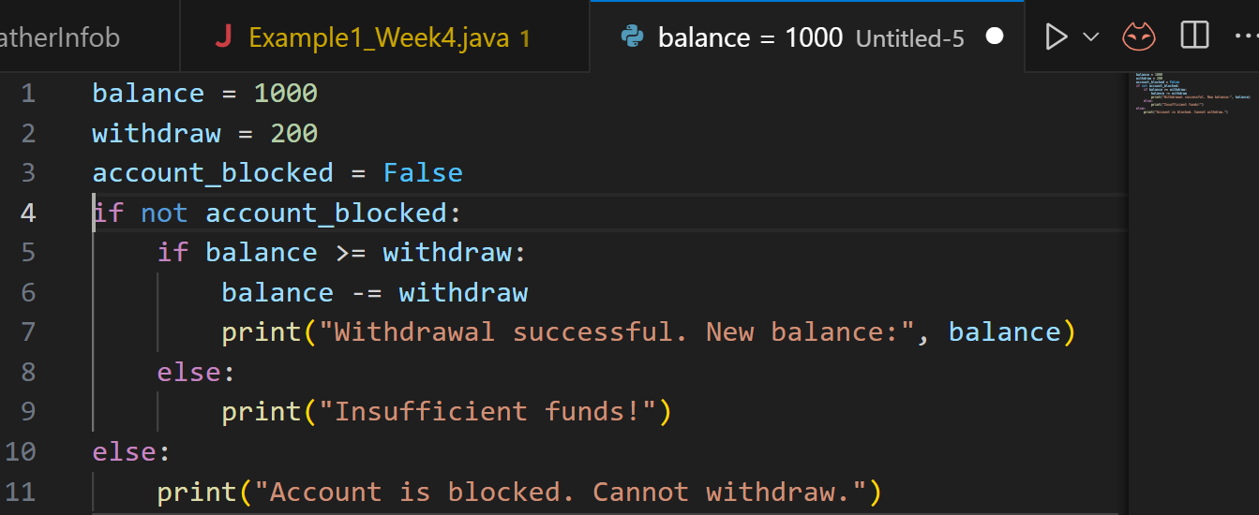
Bank Case Study (Link to Lab 4)
Step 1: Simple example: The following code simulates a simple banking withdrawal:
balance = 1000 → account starts with $1000.
withdraw = 200 → trying to withdraw $200.
account_blocked = False → account is active.

Slide 23
Bank Case Study (Link to Lab 4)
If the account is not blocked, then:
If balance ≥ withdrawal → deduct money and show new balance.
Else → show “Insufficient funds!”
If the account is blocked, print a warning.

Slide 24
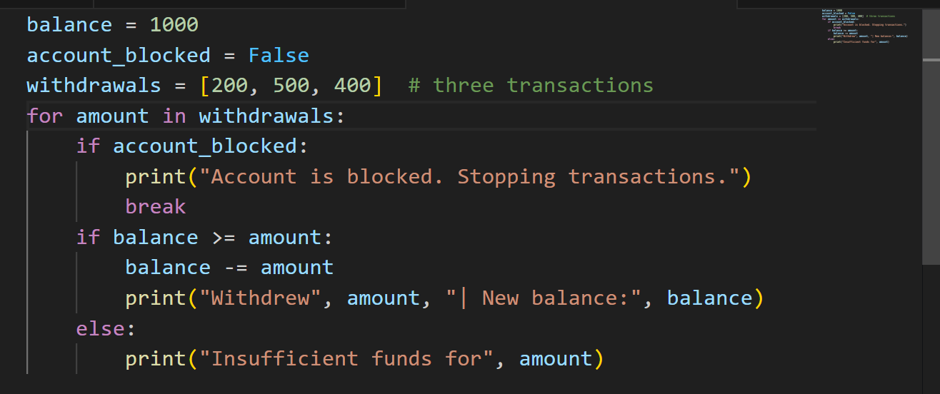
Bank Case Study (Link to Lab 4)
Program goes through each withdrawal in the list.
If the account is blocked → it stops immediately (break).
Otherwise, it checks balance before withdrawing.
Step 2: Add Loop for Multiple Transactions

Slide 25
Activity 3: Try Different Transactions
Change the withdrawals list to [100, 300, 700].
Observe how the program responds when balance is not enough.
Goal: Students see how conditions work for different inputs.

Slide 26
Activity 4: Simulate a Blocked Account
Set account_blocked = True.
Run the program.
What happens?
Goal: Students see how break stops the loop immediately when account is blocked.

Slide 27
Learning Reinforcement (2 min)
Research Discussion Questions
1. Why are control statements compared to "decision-making" in real life?
Because they decide what happens next in a program just like we decide based on conditions (e.g., weather → carry umbrella or not).
2. Which control statement is most used in real-world apps in Australia (e.g., MyGov, Opal card, online banking)?
Mostly conditional checks (eligibility, balance, login).

Slide 28
Activities 5 and 6
Activity 1 (Java): Write a program that checks if a customer is eligible for a student Opal card (age < 25).
Activity 2 (Python): Write a loop to display numbers from 1–10, but skip 5 using continue.

Slide 29
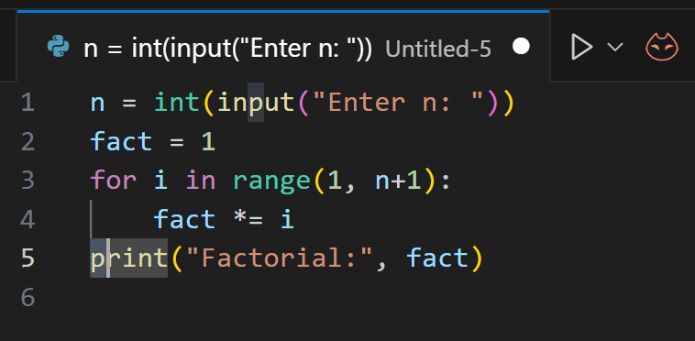
Problem-Solving Example (Factorial – Lab 4 Ex.8) - Python
Task: Write a program to calculate factorial of n (entered from keyboard).

Slide 30
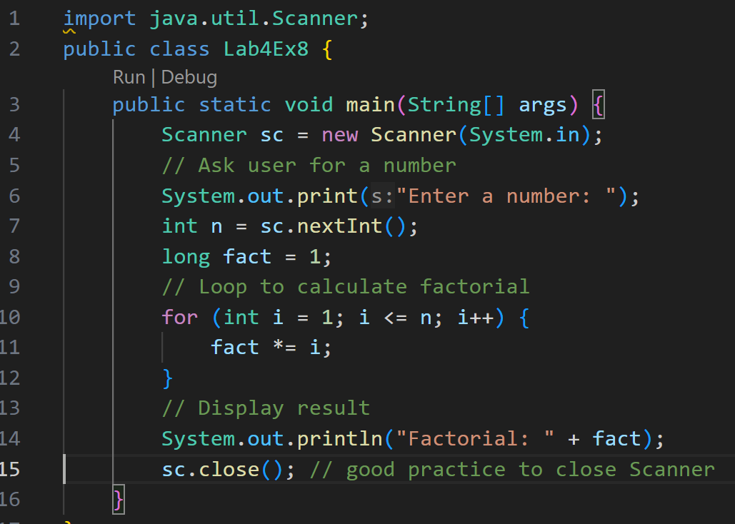
Problem-Solving Example (Factorial – Lab 4 Ex.8) - Java
Task: Write a program to calculate factorial of n (entered from keyboard).
1. Import Scanner: Scanner is used to take input from the user (like typing a number in the console).

Slide 31
Problem-Solving Example (Factorial – Lab 4 Ex.8) - Java
Task: Write a program to calculate factorial of n (entered from keyboard).
2. Class and Main Method: Every Java program must have a class.
The main method is where the program starts running.

Slide 32
Problem-Solving Example (Factorial – Lab 4 Ex.8) - Java
Task: Write a program to calculate factorial of n (entered from keyboard).
3. Create Scanner Object: Creates a Scanner to read input from the keyboard.

Slide 33
Problem-Solving Example (Factorial – Lab 4 Ex.8) - Java
Task: Write a program to calculate factorial of n (entered from keyboard).
4. Ask User for a Number: Program asks: "Enter a number:"
Whatever the user types is stored in variable n.

Slide 34
Problem-Solving Example (Factorial – Lab 4 Ex.8) - Java
Task: Write a program to calculate factorial of n (entered from keyboard).
5. Factorial Logic:
fact starts as 1.
The for loop multiplies numbers from 1 to n.
Example: if n = 5 → fact = 1 × 2 × 3 × 4 × 5 = 120.

Slide 35
Problem-Solving Example (Factorial – Lab 4 Ex.8) - Java
Task: Write a program to calculate factorial of n (entered from keyboard).
6. Print Results:
System.out.println("Factorial: " + fact);

Slide 36
Problem-Solving Example (Factorial – Lab 4 Ex.8) - Java
Task: Write a program to calculate factorial of n (entered from keyboard).
7. Close Scanner:
Closes the Scanner (good practice to free resources).

Slide 37
Problem-Solving Example (Factorial – Lab 4 Ex.8) - Java
Task: Write a program to calculate factorial of n (entered from keyboard).
User enters a number (e.g., 5).
Program multiplies numbers from 1 to n.
1 × 2 × 3 × 4 × 5 = 120.
Prints: 120

Slide 38
Activity 7
Modify factorial program to reject negative numbers.
Add condition: If n > 20, display “Too large to calculate” and exit.

Slide 39
Role-Playing Debate Questions (2 min)
Debate 1: Should programmers always prefer for loops over while loops?
No, for is good for known ranges; while fits unknown conditions.
Debate 2: Is break a bad practice because it makes logic less clear?
Depends – in banking/security apps, sometimes it simplifies code, but overuse makes code hard to read.

Slide 40
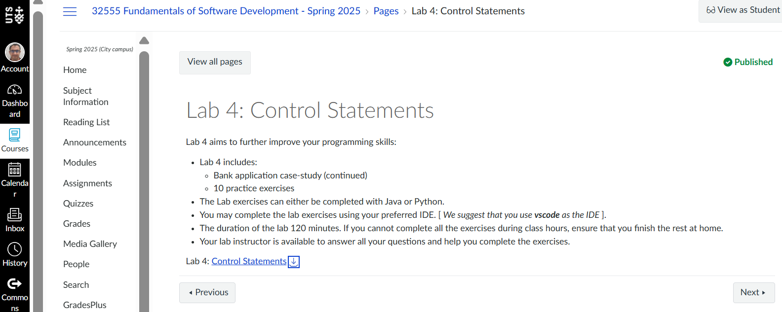
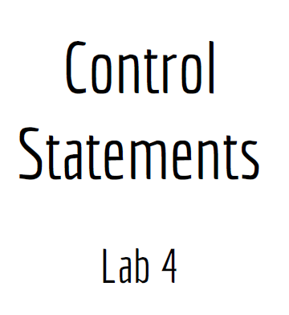
Lab 4 Exercises

Slide 41
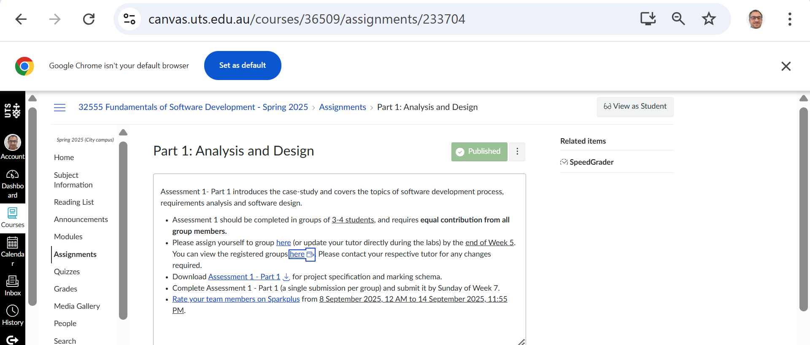
Have you formed your group?

Slide 42
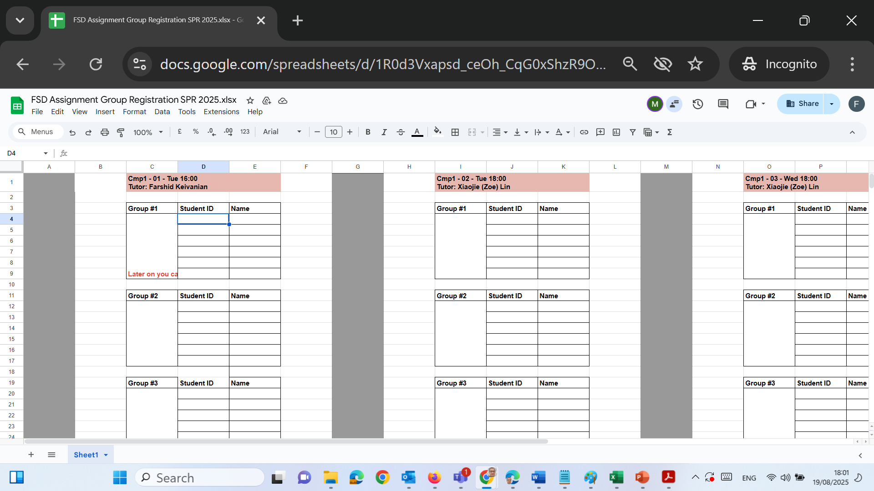
Have you formed your group?
Please send me an email listing your group members and kindly CC all members of your group in the same email. This will help us keep everything clear and ensure everyone is informed. Farshid.Keivanian@uts.edu.au
Once I receive your email, I will fill in the online sheet with your group details and share it with the Unit Coordinator.

Slide 43

Happy Learning and Bright Futures Ahead! Dr. Farshid Keivanian Stay Connected: linkedin.com/in/farshid-keivanian github.com/FarshidKeivanian
Education is the most powerful weapon you can use to change the world. — Nelson Mandela

